Slide 1
Japan: Imminently Aged: Lessons to be Drawn, Issues to Confront
Peter S. Heller
Visiting Scholar, School of Advanced international Studies
The Johns Hopkins University
February 7, 2012

Slide 2
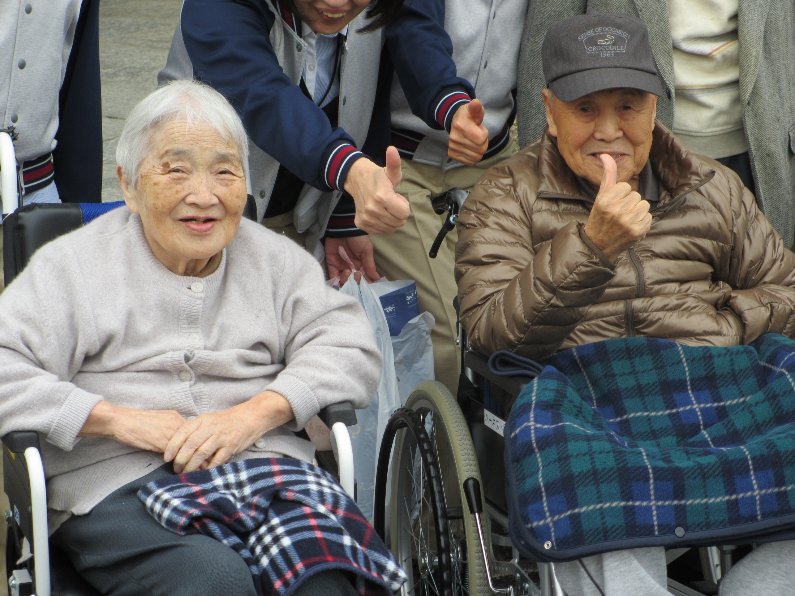

Slide 3
Introduction
Origins of the paper
  Japan as the leader among the “flock of aging Asian and industrial country geese”: What lessons—both positive and negative--can other aging countries—industrial and developing-- draw from Japan’s approach—its policies and institutions? What policy issues to confront?
This presentation:
  provides external reflections on how Japan is approaching the challenges of an aged population
  Will not reiterate Japan’s demographics
  Will assume familiarity with Japan’s pension, medical care and long term care systems
Recognition that this paper derives from large body of fascinating and important work by many Japanese scholars and government officials: the issue of Japan’s aging has long been studied and considered!
Seeking feedback

Slide 4
Outline of the talk
Some broad lessons for policy in the face of a rapidly aging population
Constraints: “Macro,” “Micro,” and Political Economic
Japan’s approach to social security in a world of an aged population
What will Japan look like in 2026?

Slide 5
Part I: Japan is the first of the industrial countries to confront a new demographic reality which is forcing—with difficulty--new ways to think about society and social policy.

Slide 6
Multiple criteria needed to judge whether policies for an Aged and Shrinking population are successful
Fiscal sustainability
Fairness in inter-generational burden sharing
Promotes the well-being of the population
  Healthy life expectancy and access to quality medical care
  A fair income distribution
  Environmental quality
Fosters Japan’s long-term welfare—concern for the citizens of the future
Preserves Japan’s cultural integrity & distinctiveness
Acceptability to the Japanese people

Slide 7
Lesson 1: Avoid overemphasizing the “agedness” of a population in policy frameworks
Japan—like others--failed to recognize and respond quickly enough to the change in the “demographic norm”—the shift to a world of low fertility and high, long life expectancy and the functionality of the elderly under age 75
Living beyond 65 with limited functionality is no longer a risk to insure against: is now the norm
The inappropriateness and high cost of building policies that imply 25-30 years of retirement. Setting retirement age at 60 or even 65 is
  Costly to individuals to save for;
  Costly to society to finance through social insurance schemes paid for by working-age generation; particularly
    As the 15-64 population shrinks
    When many elderly are physically able to be in the labor force
Underscores importance of preventive policies that enhance the quality of life and degree of functionality of the elderly years
Notes:
Shifting employment structure—less physical work

Slide 8
Policy message for other aging countries
Move quickly away from enshrining a specific age as the point for entitlement to retirement, pensions, favorable social privileges
  policies need to be flexible and responsive and introduced with a long lead time
Where possible, ensure that actuarial principles determine the magnitude of benefits

Slide 9
Two corollary lessons
Corollary lesson 1a: Differentiate among the elderly
  The functionality of the 65+ group and even 75+ group is changing
  Don’t treat all elderly (65+) as a “dependent” group
  Illustration: Study by Sanderson and Scherbov (Science, 2010)
  Prospective Old Age= Population with LE< 15 years
  Dependency Rate (POADR) 20+ population with LE>15 years
  (LE= life expectancy)
  Adult disability dependency= Adults >20 with disability
  rate (ADDR) Adults >20 without disability

Slide 10
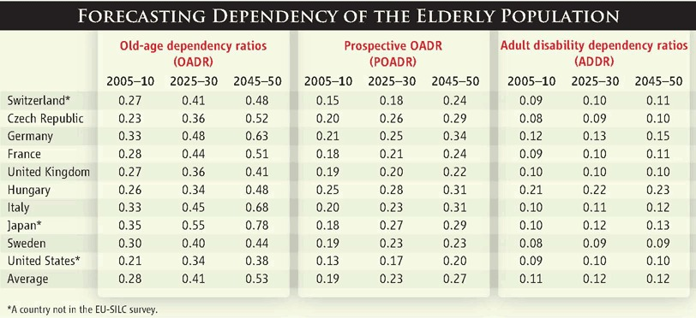

Dependency ratios.
W. C. Sanderson, S. Scherbov Science 2010;329:1287-1288
Published by AAAS
Notes:
Dependency ratios. Authors' calculations. OADR and POADR are based on (11). ADDR based on (11) and (28). The lower age boundary in all denominators is 20. See SOM §1 and tables S1 and S2 for more detailed methods and additional countries.

Slide 11
Two corollary lessons
Corollary lesson 1a: Differentiate among the elderly
  The functionality of the 65+ group and even 75+ group is changing
  Don’t treat all elderly (65+) as a “dependent” group
Corollary lesson 1b: Japanese business and government need to reconsider employment practices, seniority-based wage profiles, training and education.
  What policies foster productivity throughout the labor force?
  Highlights importance of Japan’s debates about
    mandatory retirement age
    Nature of the wage contract after age-60
    Youth employment and underemployment

Slide 12
Lesson 2: The Challenges of an Aged Society extend beyond pensions, medical and long-term care!
Requires active promotion of:
  Structural reforms that facilitate productivity across sectors and among different age groups
  More efficient labor markets
  Policies to support fertility
  Investments in human capital—the young and the elderly
  Targeted immigration policies
  Policies that facilitate changes in sectoral production patterns as between services and manufacturing
  Reconciliation of evolving infrastructural needs and changing spatial patterns of residence and employment
This requires coordination in policy across sectors and overriding the “silos” which now characterize policy formation

Slide 13
Lesson 3: Solving a Government’s financial problems is not the same as ensuring that the elderly can meet their financial needs
Can Japan’s current and soon-to-elderly finance their consumption needs over their lifetime?
  Policies to address fiscal imbalances will involve higher taxes, reduced benefits, higher social insurance premia and co-pays
  Most of Japan’s elderly well-positioned in terms of pension income, financial and real assets, and family support
  But relatively high elderly poverty rate (OECD) suggests significant gaps.
Two implications to examine
  Need a focus on (i) public assistance policies or size of basic pension;
(ii) potential role for refundable tax credit; and (iii) reverse mortgages;
(iv) preventive health measures
  Looking forward, will all elderly after 2025 be similarly well-positioned to finance their elderly years?
  Concerns about neets, freeters, parasite singles, and dropouts from social insurance system
Notes:
But much more needs to be done on other central elements that shift the focus away from societal support of the elderly years: this includes greater efforts at preventative health measures in the working age years (to promote healthy aging); facilitating labor force participation of the healthy elderly; fostering voluntary pension savings schemes; and supporting markets that facilitate the provision of infrastructure, housing, and services that are adapted to the needs of a more elderly population.

Slide 14
Part 2: Fundamental questions that confront Japan in the face of an imminently aged population
1. Can it restore durable long-term per capita income growth and fiscal sustainability?
2. Can it realize a socially acceptable degree of inter- and intra-generational equity?
3. Can it overcome political economy obstacles that block policies to achieve 1 and 2?

Slide 15
Lesson 4: There are both macro and micro issues to face with an aged population! Neither can be ignored!
The “macro” constrains what is feasible--in terms of micro and sector-specific relationships—for both government policy and households
And “micro” decisions of government and households influence the macro outcomes: affect savings, govt expenditures and revenues
Implications for Japan
  Japan’s capacity for policy actions with regard to an imminently aged population is heavily constrained by its excessive public debt
    A focus on GDP per capita alone insufficient; need nominal GDP growth!
  Failures in macro policy—particularly fiscal--will force more difficult micro adjustments in policies and fiscal transfers to the elderly
  Qualify judgments on Japan’s policy successes (LT or medical care) by recognizing the large amount of underlying debt financing
Notes:
(e.g., Horioka: cuts in social security expenditures, increased contributions, increase dissavings among retired elderly: accelerate point at which net private savings may fall below point of increased govt debt; Likewise, if elderly continue to work, reduced dissavings; do dissavings stimulate more savings by younger (less bequests?); reduced benefits/increased pension ages—may stimulate HH savings
Viability of relying on consumption tax increase in the absence of the policy instrument of refundable tax credits (even if elderly partly shielded by CPI adjustment); or for that matter of increased co-pays of very elderly
(e.g., obviously govt policy decisions on benefits/contributions affect govt outlays

Slide 16
    Lesson 4 (cont): Warning to other aging countries: Don’t approach an aged population with high Debt to GDP ratio!
Getting the macro right enables
  More predictable and unconstrained policy environment for adjusting micro policies
  Provides fiscal space when expansionary policies are needed and for more gradual changes in hard-to-change social institutions
  Allows government to focus on other societal problems besides those of the elderly
  Reduces vulnerability to exogenous shocks and enhances capacity for appropriate response to future shocks
Policy reforms that adjust pensions, health and long-term care are necessary but not sufficient to realize a macro policy stance appropriate for the long term

Slide 17
Lesson 5: Japan waited too long (and perhaps is still waiting too long) to adjust its social insurance system
Much of current public debt reflects growth of social expenditures since 1990. Yet by 1990, the demographic picture was clear!
I do recognize that macroeconomic policy was concerned with recession and the post-bubble period
But aging-focused policies still could have been initiated earlier:
  to change pension eligibility ages;
  conditions of access by elderly to health insurance;
  to introduce macro slide and symmetric indexation;
  to consider pension privatization or funding schemes

Slide 18
Lesson 6: Japan’s experience: Who should bear the financial burden of an aged population?
Caveat 1: Government policies are only one of many determining factors:
  Individuals--through family relationships—determine amount of intergenerational family support
  Markets—influenced by both demographic change and globalization—affect asset prices and relative factor prices--and thus how the burden is distributed among generations
    Example: Age structure ➡ the value of housing wealth owned by elderly and the cost of housing to younger cohorts;
    Age structure ➡ value of any bequests
Caveat 2: Past justifications of “pay as you go” policies no longer viable when age structure turns rectangular: raises many difficult ethical questions
    Past justifications: current elderly supported their parents etc so social solidarity should apply to current work force
    Are the elderly responsible—in terms of their investments and work effort-- for the current income levels of the nonelderly?
    Elderly chose low fertility (less human capital investments)➡ should they thus have saved more?
    Do “social insurance” principles apply when it is chronic, not acute illness, that influences demand for medical care?

Slide 19
Lesson 6 (continued)
Japan’s policies recognize need for a sharing of the burden
  Ceilings set for maximum pension contribution rate
  “Macro slide” policy was intended to shift some burden to elderly
  Renewed emphasis on consumption tax recognizes need for a sharing of the burden by elderly
  Increased medical co-pays for elderly 65-74, increased tax financing of health services for elderly, and transition to 75+ (from 70+ for health services to elderly scheme)
  Evaluation of LT care needs and shift to LT care insurance does limit burden on health insurance premiums
  Charging for bed and board for much long-term care
  Elderly do pay nontrivial medical and long-term care insurance premia

Slide 20
Lesson 6 (continued): But, Japan….
Still relies on PAYG approach for much of pension outlays ➡ analyses suggest inequity in generational accounts, particularly for younger and future generations
Not yet implemented the macro slide because of deflation ➡ increased real pension benefits for current elderly
Large fiscal deficits imply substantial shifting of public debt burden to future generations
Baby boomers will not be affected by any deferral of the pension eligibility age
Heavy cross-subsidization by working age groups to finance elderly medical insurance benefits (note increase in wage bse for health premiums with inclusion of biannual bonus)
Elderly pension benefits largely tax exempt (an EEE system)
General taxpayer (viz., still mostly nonelderly) finances much of the basic pension, long-term care, and medical care for 75+
Intergenerational transfers highly nontransparent: confusion exists as to appropriate application of insurance vs. welfare (tax funding) principles
Notes:
Question 1: Does nontransparency facilitate passage of reform legislation that raises burdens on elderly and reduces benefits?
Would transparency make reform more difficult in Japan
Question 2: Does Japan excessively foster a distinction between “social insurance contributions” and “taxes” that masks the extent to which the former are actually taxes used for intergenerational support:
Example: Politicians said to prefer increased social insurance contributions to taxes: they get blamed for latter; bureaucrats of MHLW get blamed for former!
Nontransparency due to
cross subsidization mechanisms
various income tax provisions
lack of adequate incidence analysis
Masking of tax component of social insurance premiums

Slide 21
Lesson 7: Japan: Offers poor lessons on overcoming political economy challenge: elderly and vested interests still rule!
Present electoral system biased towards the elderly and key constituencies: block reforms that could foster productivity increases (agriculture, medical care, services)
Japan experience raises several obvious questions:
  How much of these political obstacles are a function of demographics (an aging population)? As opposed to power of many vested interests against reform?
  Does Japan’s experience suggest to do policy reforms before the aged become a large voting bloc?
    In effect, one needs to exploit a “political economy window!”
  Does an aging society lose the dynamism to implement significant reforms? Can it respond vigorously to a crisis?
  Will Japan prove another example of: “it takes a crisis….”?
Notes:
The literature on the “demographic dividends” of the demographic transition needs to highlight more the “political economy window” that is available to implement policies that address the obvious long-term challenges associated with a future aged population

Slide 22
Lesson 8: Negative Lesson: Japan has not taken advantage of periods of demographically-facilitated growth to implement difficult or radical reforms!
Could argue that Japan did not use supportive demographic conditions of the last 20 years to realize further growth
  Was still in positive phase of demographic transition (high labor force) but real growth stagnated during this period.
Post-1990, Japan suggests difficulties of implementing policy reforms when economy is weak

Slide 23
Lesson 9: Recognize that policy windows for reforms for growth can close
The next 10-15 years are a window for important policy gains
  Deal with public debt while baby boomers are still among the “young old”
  Exploit their potential for labor force participation
  Limit the deferral of debt burden to unborn generations
There is no shortage of excellent thoughtful proposals by Japanese businesses, scholars, and policy markers as to what is needed to revitalize the economy:
  ESRI: Japan’s 21st Century Vision
  Keizai Doyukai: Vision of 2020
  Keidanren Growth Strategy 2011
  Innovation 2025
  McKinsey: Reimagining Japan: the Quest for a Future that Works
Notes:
Many policy suggestions as to what is needed:
-- Restore fiscal sustainability
-- TPP as starting point
--Transition to a Green Society
--Local and regional revitalization
--Deregulation of service and agricultural sectors
--Reform the labor market
--Reform of education system
--Stimulating innovation (science and technology, finance, ICT
--Exploiting Japan’s comparative advantage as a leader in responding to an elderly population
--Holding down labor costs for employers
--Tax and social insurance reform to induce greater domestic investment

Slide 24
Part 3:
The strengths and weaknesses of Japan’s social insurance system in the face of an imminently aged society a. “universal” social insurance, but… b. Pensions c. Medical care d. Long-term care

Slide 25
Lesson 10: In Japan, “universal social insurance policies” mask disparities in burdens borne by different groups
Differences in premiums may apply
  Across workers of different firms (e.g., health premia)
  Across municipalities, in premiums paid by workers and elderly for medical & long-term care insurance
  Employed women vs. housewives
  Significant noncompliance among temporary workers and unemployed
Differences in benefits derived
  Across different municipalities
  Across places of employment
  As between spouses working part-time, full time, or as housewives
  Within programs (e.g. preventive health checkups)
Elderly poverty rates in Japan are high among OECD countries
  May further increase when baby boomers retire
  System gives low priority to low-income single elderly women and single parent households with children

Slide 26
Lesson 11: Pensions: financial and economic problems have been engendered by delaying reform with changed demographics
Reforms delayed or not initiated
  Adjusting the age for pension eligibility—happening too slowly and not linked to longevity
  Implementation of the “macro slide” to take account of the change in underlying demographic parameters (longevity and labor force size)
  Implementation of symmetric indexation mechanism; no downward adjustment of pension benefits with deflation has increased real benefits
  Reconsidering implicit rate of return on pension contributions across age cohorts
  Reconsidering whether benefits for high income earners should be reduced
  Addressing concerns that high social insurance premium on employers may hinder domestic investments, sectoral shifts, and job creation, particularly needed to facilitate adaptation to new global economic environment and a reduced population

Slide 27
Consequence of delays:
Prevented improved primary balance and increased public debt
Contributed to resistance of elderly to making any changes
Have impeded adjustment of economic agents to need to work longer and to save more for retirement:
  prospects of adjustment easier when expectations of later retirement are revised earlier in life
  Will make it difficult for Japan to exploit the coming 11-14 year window when baby boomers are still healthy enough to work
Have crystallized perceptions of intergenerational inequities, particularly among younger cohorts: revising such perceptions will require stronger reforms ➡ contribute to noncompliance problem
Have increased the “double burden” challenge that would arise from any possible policy shift to a “defined contribution pension system”
Have intensified the focus on the fiscal imbalances created by the pension system and away from the adequacy of the pension system to address income risks faced both by future as well as current elderly

Slide 28
For an aging & aged society, reforms related to retirement risks must address 4 critical concerns
Contribute to minimizing income risks (MIR) associated with uncertain number of unhealthy elderly years
Foster intergenerational equity and a “fair” society (IE)
Be compatible with macro and fiscal stability (FS)
Minimize allocative distortions that limit current and future employment and growth (SS)
Some policy instruments can contribute to multiple objectives: “killing 2 birds with one stone”

Slide 29
Japan: Policy reforms to consider
Immediate adjustment of current pensions downward for amount of deflation since 2004; immediately implement macro slide and symmetric indexation mechanism (IE, FS) (Note Sweden’s policies in 2009-2010)
Gradually increase consumption tax to at least 15-20 percent (FS, IE)
Exclude consumption tax effects from CPI for purposes of pension indexation (FS,IE)
Introduce progressivity in terms of reduced pension benefits as pension income rises (IE, FS)
Gradually link eligibility age for pensions to longevity (FS, IE)
Nonexemption of pension benefits from income taxation (IE, FS)
Consider either refundable tax credit or guaranteed minimum pension (a la Sweden), means tested (MIR. IE)) (note Sweden’s approach)
Finance 100% of basic pension from consumption tax; replace present earnings-related social insurance contribution with mandatory notional DC scheme (eliminating employer contribution) (SS) (IE)
Introduce tax payer ID number and strengthen tax administration to ensure fairness in compliance by tax payers (SS)
Reduce threshold exemption for inheritance tax and increase rates (IE)
Notes:
When govt policy is prescriptive on the R o R, clawack desirable
Complementary policies needed to deal with key risks (beyond UI, disability); to reduce poverty
Forward looking: awareness of ST crisis; but less focus on long term challenges that pensions policies will create with changing labor force; is it adequate policy for the future; is it well adapted for situation 20-30 years in the future
Pensions policy important weapon in arsenal for facilitating adjustment of economic actors to changing demographic conditions and as a form of risk insurance

Slide 30
Lesson 12: Long-term (LT) care: though still evolving, an excellent model for other aging countries
Appropriately uses insurance principles to extend the risk pool to the entire population at risk
Intelligent approach for determining levels of support and care required for each eligible individual on the basis of mental and physical status; a mechanism as well to limit costs associated with long-term care insurance
Bolstered by preventive health initiatives

Slide 31
Lesson 12 (cont.): Long-term care: concerns for the future
The system remains to be stress tested—and will be—in next 10 years when baby boomers turn 75; will be challenged by:
  Inadequate coordination between LT care and medical systems, as multiple chronic diseases need different kind of management
  Inadequate support from doctors
  Quantity, quality, and low pay of LT care managers
  Shortage of carers: a need for reformed immigration policies
  Inadequate number of non-medical LT care beds
  Differing capacities of municipalities for implementation
  Capacity limitations if number of dementia cases increases in 10-15 years, within 75+ population
Budgetary bias towards home-centered care will be equally challenged by increasing number of single person households (particularly widows) living apart from their children;
  This bias will also make it hard for women to enter the labor force

Slide 32
Lesson 12 (cont): And markets and policy makers still have much to learn about Japan’s very elderly population
Many unanswered policy relevant questions:
  Likely incidence of dementia at different ages?
  Can preventive measures forestall dementia?
  What are ways that medical and LT care can contribute to reduced levels of disability and care level needs (avoiding increased unhealthy years), particularly for multiple chronic health conditions?
    e.g., treat the acute episode (stroke), but not disability/dysfunctionality
    e.g., disability associated with social hospitalization
  Will changes in diet, exercise, stress among those now of working age change the pattern of morbidity of the future very elderly?
  How much do genetic factors in Japan limit the value of drawingt on cross country experience?
Research on these questions is vitally needed on which to base Japan’s policy practices

Slide 33
Lesson 13: Medical care: Beware of cross-country comparisons as a measure of success
Japan fares well relative to other OECD countries in terms of ratio of medical spending to GDP (relatively low) and outcomes (high longevity)
Much commendable about the quality of medical care in Japan, dedication of its health manpower, and accessibility to care
The system works (!), is affordable, and is acceptable to citizens. Areas of dissatisfaction are offset by high accessibility and the escape valve for those with the financial resources to access desired care
But, the system relies on significant cross-subsidization of the elderly by workers and employers
Also, the system has many limitations and inefficiencies, a questionable allocation of resources, and displays some less satisfactory measures of health outcomes
Notes:
Not socialistic: note inequality in premia paid across working age cohorts; private practitioners play major role in the system
But highly regulated and managed as well: drug and procedures prices set by government; for-profit institutions in medical care are not allowed; government hospital institutions play an important role in medical care delivery

Slide 34
Lesson 13 (continued): The limitations include:
  An excess of quantity—too many hospitals of inefficient size; too many beds used for LT care; too many outpatient consultations of excessive brevity; excessive use of expensive equipment per capita; too easy access to specialist resources
  Resource allocation favors clinic MDs as opposed to public sector MDs and public hospitals
  Uneven compensation patterns for physicians in clinics, municipal and university hospitals: do not match skills, work effort and likely outcomes
  Significant differentials in quality across institutions; for sophisticated treatment, often low volume of cases for specialists compromises quality
  Inappropriate incentives guiding physician behavior and investment decisions;
  Lack of gatekeeper system and limited role of general practitioners further compromises efficiency in resource allocation and management of community health risks
  Significant weaknesses in hospital management in many municipal institutions
  Inefficiencies in nonmedical supply systems

Slide 35
Lesson 13 (continued): Also note that
  Improved longevity not much attributable to medical care: reflects strong past public health measures, legacy of good diet and exercise for present elderly cohort, basic attributes of the medical care system in terms of dealing with infectious diseases and infant mortality, and role played by emphasis on preventive care
  Increased longevity is now accompanied by increasing number of unhealthy life years
  And changing life styles may erode Japan’s record. (Note: high incidence of suicides and still high smoking rates)

Slide 36
Lesson 14: Rising number of elderly will challenge how Japan’s medical care system is structured and financed
The system may become inefficient and costly as population age structure changes and morbidity structure shifts more towards multiple chronic diseases needing less acute care and more chronic care management
Increased demand by elderly may increase cost burden on the health financing system, both from taxes and social insurance
Current system of cross-subsidization of the CHI will lead to heavier burden on employers and working age groups, particularly as latter shrinks. Will employers stay with health associations? Or shift to CHI?
How long can MHLW manage the increased demand by cutting physician payments or drug prices?
What supply pressures will emerge with increased volume of demand? Does today’s spatial distribution of medical supply match the likely sources of demand as population ages further?
Will restrictions on for-profit institutions limit capacity of the system to respond to changing pattern of demand?
How much pressure will emerge from new technologies?

Slide 37
Lesson 15: Japan’s health care system illustrates
Dr. Ikegami’s maxim that “institutions change more slowly than demographics”
Realizing institutional change is a very slow, inertial process, particularly when strong vested interests—attitudes, rents, and ways of doing things that are embodied in physical and human capital—associated with practices in a sector
Institutions constrain what policy designs are feasible, what reforms can occur, and how quickly they can be implemented
Most likely, pressures on medical care system will be met by higher level of medical outlays than by reform of existing inefficiencies

Slide 38
Part IV
Japan in 2026: three plausible scenarios
Caveats on drawing “lessons” from Japan’s experience for other aging countries

Slide 39
Final Lesson 16: Countries experiencing significant demographic change and macroeconomic uncertainty should make greater use of scenario analyses
What are they? Scenarios provide alternative descriptions of the future: all plausibly derived from today’s situation
What they are not? NOT forecasts. They do not assign a probability of occurrence
Why do them? To help policy makers visualize alternative possible futures, to gauge robustness of policies across different futures, and to motivate policy action.

Slide 40
Illustration: Three externally-modulated scenarios for Japan in 2026
Externally modulated: Each scenario would be affected positively or negatively by whether it is supported or undermined by external exogenous factors (global and regional economic conditions; the incidence of natural disasters). Each will display a stronger positive outcome with favorable exogenous factors; More negative with unfavorable exogenous factors.
Scenario 1: Japan Rebounds
  Pro-growth scenario initiated soon, with electoral reform facilitating important structural reforms (reduce barriers to FDI, entry to servics sector
  Primary surplus realized and public debt gradually reduced (net debt to 150% of GDP by 2017 and 135% by 2020)
  Deflation ended
  Consumption tax increased over decade to at least 15%,. Some reduction in employer social insurance premium and corporate tax rate facilitates revived domestic investment and increased productivity.
Notes:
Euro Crisis a point of intense vulnerability for global economy with important potential reverberations for Japan
Yen seen as safe currency—pressures for appreciation already seen
Will contribute to global demand slump, both from Europe directly and from its ramifications for US, China, and India
Both factors could contribute to serious slowdown for the Japanese economy: a Euro shock-induced recession
Would further weaken Japan’s capacity to address its own fiscal problems—its ability to rely on growth as a means of reducing the burden of it public debt.
Moreover, Euro crisis should be a wake up call with regard to the view that “Japan is different.” After the Euro, will markets refocus on the possibility that Japan could also default?

Slide 41
Scenario 2: Japan Adrift
  Only limited structural policy reforms adopted despite TPP, with real growth stagnant, negative labor force growth, and limited productivity growth
  Prices remain either static or deflationary
  Some fiscal restraint implemented—limited consumption tax increase and cut in benefits. This avoids debt default, but economy is highly vulnerable to default as total financial asset growth decelerates
  Some electoral reform occurs but key vested interests can still block significant structural reforms
Scenario 3: Japan Aged and Stagnating
  Govt defaults on JGB debt, forcing sharp cutbacks in budget, social security outlays, and capital expenditures; wealthier households suffer loss in wealth
  Real growth negative as domestic investment stagnates and with rising share of nonregular labor force and unemployed; Deflation continues unabated and real per capita income falls
  Downward demand cycle with widening gap with potential output

Slide 42
The challenge: trying to imagine the implications for Japan’s aged society in 2025 in the event of these three alternative scenarios
Demographics: scenarios would have only limited effects, though they might marginally influence fertility rates as well as immigration policies
Social security system likely to be highly sensitive to scenario outcome
  Different amounts of cutbacks in pension benefits, how much “claw back from well-off elderly,” pressures to push back pension eligibility age, and reshape basic benefits core benefit (guaranteed minimum)
  Will influence tightness of spending programs in medical and long term care as well as in the pressures for significant reform (greater in downside cases)
  Greater or lesser risks to continued universal access to medical care; level of co-pays required, as well as degree of pressure on medical supply practices
  Degree of tightening of availability of institutional LT Care and co-pays
Will see different outcomes in terms of elderly labor force participation rates and possible widened inequality among elderly
Might a crisis force greater, delayed opening up of service sectors to for-profit investment?
Scenarios would also differentially affect public service provision and investment
Effects on economic growth rate (contractionary effects from fiscal measures; pro growth effect from structural reforms)

Slide 43
A final caveat: demographic determinism has its limits
Demographics exerts powerful forces on a society. The challenges of an aging and ultimately aged society do raise similar challenges across different countries. But is “demography destiny?”
Caveats to remember
  Countries differ in many ways during the period when they make the shift to a low fertility rate and high life expectancy
    In their starting point— their income and socioeconomic attributes
    In their institutions and the degree of development of their social insurance policy frameworks
    In the international context--where a country is relative to other countries! For example, Japan suffered from being the first to encounter a financial sector meltdown in a globalized economy
  Japan benefited by being the “lead goose;” perhaps it has also proven costly, having implemented policy frameworks that now appear inefficient and costly
  Japan is encountering challenges and issues not yet faced by other countries: while costly, it may potentially be a source of gain!

